Slide 1
P2P Chat Application
Decentralized Network Communication and Custom Protocol Design
Prepared by: Soner Güneş, Ömer Faruk Olkay, Ahmet Baha Çepni
Course: Mobile Communication Networks

Slide 2
Introduction
This presentation outlines the development of a peer-to-peer (P2P) chat application designed to enable users to send messages directly without a central server. Built using Python, it aims to deepen understanding of network programming and distributed systems while facilitating seamless peer communication over a local network. Key features include peer discovery, connection management, concurrency, and optional enhancements.
Project Overview
System Architecture
Core Features
UI and Extensions

Slide 3
01
Project Overview

Slide 4
Project Goal
The projects primary objective is to develop a P2P chat application where users communicate directly without central servers. It focuses on enabling discovery and messaging within a local network and aims to provide practical exposure to network programming and distributed system concepts.
The application will support multiple users exchanging messages in real time across connected devices.
Scope:
Decentralized Architecture
Socket Programming (Low-level networking)
Concurrent data processing using Multi-threading
Hybrid use of TCP and UDP protocols

Slide 5
Technologies and Libraries Used
Language: Python 3
Libraries: Only Standard Libraries were used (No third-party tools such as ZeroMQ or Socket.IO — everything was implemented from scratch)
socket: Network communication
threading: Background listening without freezing the GUI
json: Data packaging and protocol structure
tkinter: Graphical User Interface (GUI)

Slide 6
Expected Result
Upon completion, users can easily launch the program to discover other peers on the same local network. The system will establish TCP connections directly between peers, enabling instant message exchange without reliance on external servers.
This outcome demonstrates effective use of P2P communication protocols and network resource management.

Slide 7
02
System Architecture

Slide 8
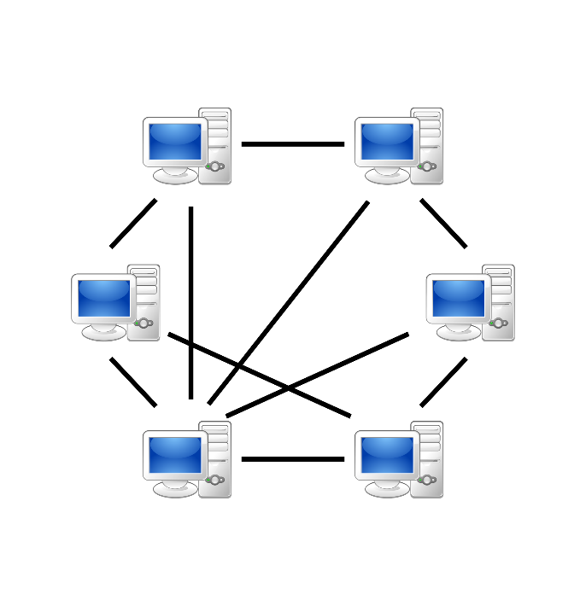

Architectural Approach (P2P vs Client-Server)
Traditional Client-Server Model: All messages are sent to a central server first and then forwarded to the target client. If the server fails, communication stops.
Peer-to-Peer Model:
Each device acts as both Server and Client (Peer)
Server Role: Listens for incoming connections (Listening Port: 5000)
Client Role: Connects to other discovered devices
No Single Point of Failure

Slide 9
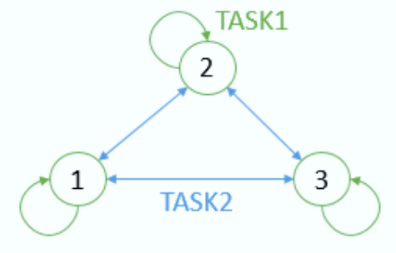
Threading
To enable simultaneous sending and receiving of messages, the application utilizes threading for concurrency management. This ensures smooth, real-time communication without blocking user input or message processing.
By leveraging these Python concurrency models, the system efficiently handles multiple tasks and maintains responsiveness across peers during chat sessions.

Slide 10
03
Core Features

Slide 11
Peer Discovery via UDP Broadcast
Protocol Used: UDP (User Datagram Protocol)
Why UDP? Because of its speed and broadcast capability. No connection establishment is required.
Method:
When a device joins the network, it sends a DISCOVERY packet to:
255.255.255.255
Subnet Broadcast Address (e.g. 192.168.1.255)
Message meaning: “I am here, is anyone else available?”
Other peers receive this message and respond with their identity information (TCP Port, Username)

Slide 12
Communication via TCP Broadcast
Protocol Used: TCP (Transmission Control Protocol)
Why TCP? Because message reliability and correct ordering are required.
Process:
After discovery, the user clicks “Connect”
Peer A initiates a TCP 3-way handshake with Peer B
A custom application-layer Handshake Request is sent
If accepted, a persistent socket connection is established for communication

Slide 13
TCP Connection and JSON Protocol
Messages are formatted using JSON, a lightweight and widely supported data interchange format, ensuring structured, human-readable communication.
Each packet has the following structure:
{
"type": "MESSAGE", // (DISCOVERY, CONNECT, MESSAGE, etc.)
"sender": "192.168.1.35", // Source IP
"payload": "Hello!", // Content
"timestamp": "2023-12-17..." // Timestamp
}

Slide 14
04
UI and Extensions GUI Interface

Slide 15
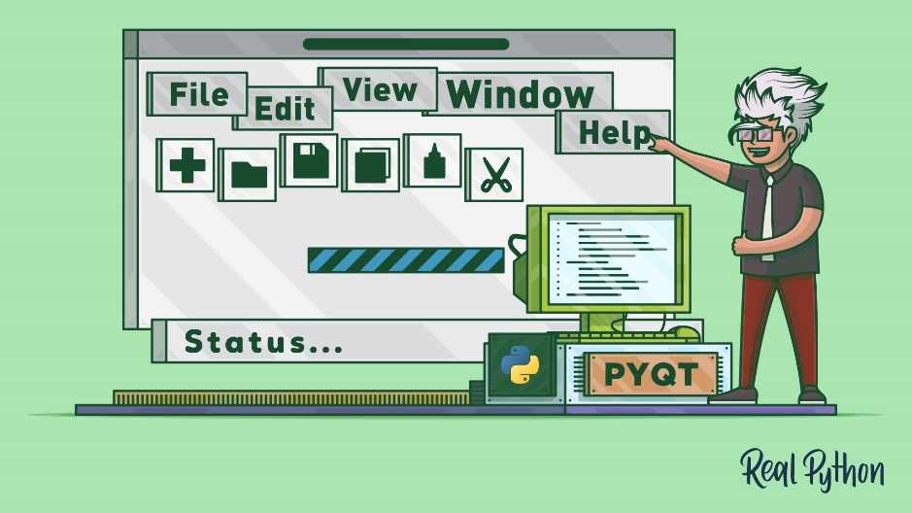
GUI - Graphical User Interface
GUI Interface:
In GUI mode, JSON fields are mapped directly to interface elements (sender name, message content, time).
Implemented using tkinter library.
Provides a user-friendly chat window, user list, and action buttons (Scan Network, Connect, Send).
Runs on the main thread while network operations execute in background worker threads.

Slide 16
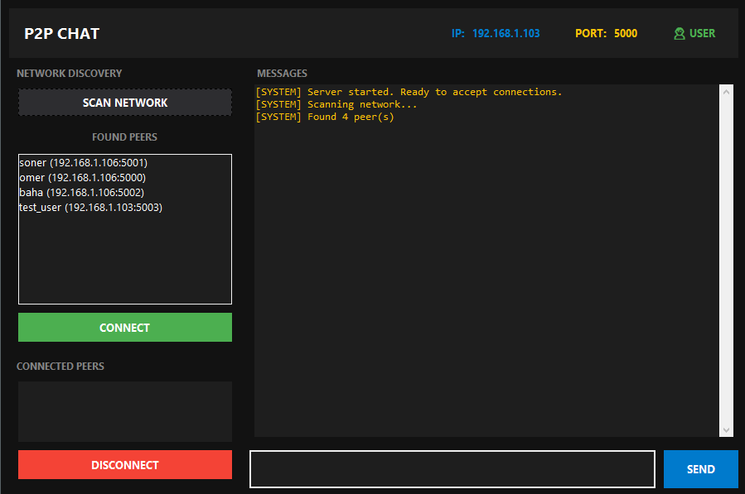
GUI EXAMPLE
User Information
Discovery Search
Discovery Result
Connected Users
Message Section
1
2
5
3
4

Slide 17
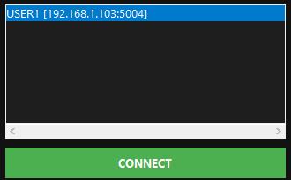
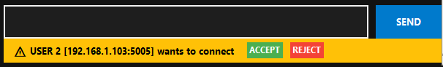
Testing on LAN Environment
Connect Request
Connect Response

Slide 18
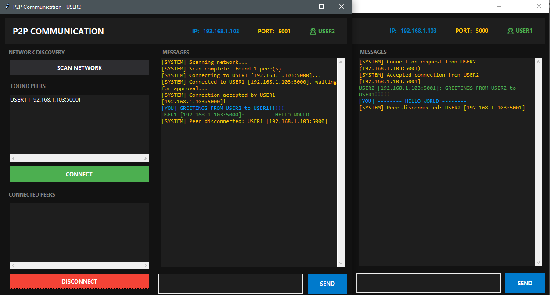
Testing on LAN Environment
Messaging / Disconnect

Slide 19
P2P Chat Application
THANKS FOR LISTENING
Decentralized Network Communication and Custom Protocol Design
Prepared by: Soner Güneş, Ömer Faruk Olkay, Ahmet Baha Çepni
Course: Mobile Communication Networks

